Slide 1
Objectives
In this session, you will learn to:
  Identify accounting vouchers
Notes:
Share the session objectives with the students.

Slide 2
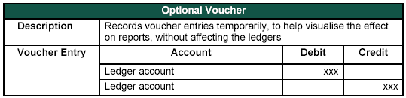
Identifying Accounting Vouchers
Optional voucher:
  It is a non-accounting voucher that is available only if the feature Use Reversing Journals & Optional Vouchers is set to Yes in the F11: Features (F1: Accounting Features).
  The following figure shows the sample entry of an optional voucher.

Slide 3

Identifying Accounting Vouchers (Contd.)
How is an optional voucher different from a memo voucher?

Slide 4

Identifying Accounting Vouchers (Contd.)
Optional voucher can be brought into one's account temporarily unlike memo voucher and its effect can be seen on financial reports.
Optional voucher is not a voucher type as a memo voucher, since all the other voucher types can be marked as optional during a voucher entry.

Slide 5
Identifying Accounting Vouchers (Contd.)
Post-dated voucher:
  In Tally.ERP 9, the voucher marked as post dated does not affect the books of accounts till the date specified in the voucher.
  It is useful for entering transactions that take place on a regular basis.

Slide 6
Identifying Accounting Vouchers (Contd.)
Let us see how to create a new voucher type.
Notes:
You need to perform the steps given under the following topic:
5.1.13 Creating a New Voucher Type (page 101)

Slide 7
Identifying Accounting Vouchers (Contd.)
Let us see how to display and alter a voucher type.
Notes:
You need to perform the steps given under the following topic:
5.1.14 Displaying and Altering a Voucher Type (page 103)

Slide 8
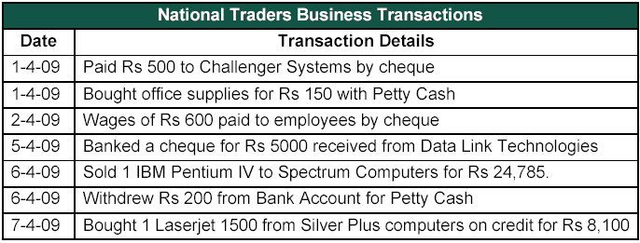
Identifying Accounting Vouchers (Contd.)
Recording Accounting Transactions:
  The following figure shows the various business transaction of National Traders for the month of April 2009.

Slide 9
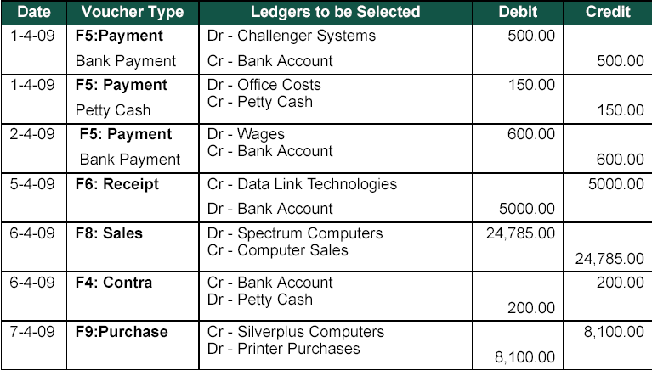
Identifying Accounting Vouchers (Contd.)
  The following figure represents the accounting vouchers in the books of National Traders.

Slide 10
Identifying Accounting Vouchers (Contd.)
Let us see how to create the accounting vouchers in the
books of National Traders.
Notes:
You need to perform the steps given under the following topic:
5.1.15 Recording Accounting Transactions (page 104)

Slide 11
Identifying Accounting Vouchers (Contd.)
Let us create trial balance for National Traders.
Notes:
You need to perform the steps given under the following topic:
5.1.16 Trial Balance for April 2009 (page 107)

Slide 12
Summary
In this session, you learned that:
  An Optional voucher is not a voucher type. All other voucher types (except non-accounting vouchers) can be marked Optional during voucher entry.

